Slide 1
PEP architecture
Kai van Lopik

Slide 2

PEP
Polymorphic Encryption and Pseudonymization
It encrypts!
It pseudonymizes!
It does so polymorphically!

Slide 3

Shared secret encryption
A
B
The quick brown fox
AX5GnBHDY&8LPh&!!
The quick brown fox
C
Secure channel to share secret
Risk of secret leaking
Risk increases with number of recipients
The quick brown fox

Slide 4



Asymmetric key encryption
A
B
Hkadg*%4GFI))*9997
The quick brown fox
The quick brown fox
)(*UH>BXKBSDUSUYF
C
Secrets kept local
Only public and encrypted information transmitted
Sender re-encrypts for every recipient
The quick brown fox

Slide 5
Repository storage
A
Hkadg*%4GFI))*9997
The quick brown fox
The quick brown fox
)(*UH>BXKBSDUSUYF
C
Repository re-encrypts for every recipient
Risk of repository breach
The quick brown fox

Slide 6
Encrypted repository storage
Hkadg*%4GFI))*9997
A
Hkadg*%4GFI))*9997
The quick brown fox
The quick brown fox
)(*UH>BXKBSDUSUYF
C
Reduced risk of repository breach
Repository retains private key: can access plaintext
Repository is trusted not to abuse this ability
The quick brown fox

Slide 7


Polymorphic encryption
Hkadg*%4GFI))*9997
A
Hkadg*%4GFI))*9997
The quick brown fox
)(*UH>BXKBSDUSUYF
C
Polymorphic re-encryption for different recipients
Repository cannot access plaintext
Effectively end to end encrypted from uploader to downloaders
The quick brown fox

Slide 8
PEP
Polymorphic Encryption and Pseudonymization
Data repository with built-in encryption and pseudonymization
Based on ElGamal encryption system
Pseudonymization uses same mechanism

Slide 9







Components in the PEP system
PEP stores data
...uploaded by clients
...but users must authenticate first
...which we outsource
Authenticated users get cryptographic stuff
...that serves as a basis for authorization
Access is vetted by multiple servers
...spread across multiple hosting parties
...as are other servers
A separate server helps data gathering
Bulk storage can be outsourced
...since it only sees encrypted data
PEP’s primary purpose is context isolation
But from a user’s perspective...
PEP just stores data
client
Client
(machine boundary)
(context boundary)
server
servers
Storage
Facility
Auth
Server
Key
Server
Access
Manager
Trans-
cryptor
Registration
Server
External
(3rd party)
Page
Store
Identity
Provider

Slide 10

Polymorphic encryption
(no decryption below this line)
Encryption
In Transit
Encryption
At Rest
Asymmetric
Encryption
Homomorphic
Encryption
End to End
Encryption
PEP just stores data
Uploaders encrypt data
...before uploading them into PEP
...and PEP stores the encrypted version
Other users can connect
...using individual cryptographic materials
PEP re-encrypts data for individual downloaders
...without PEP seeing the decrypted data
But from a user’s perspective...

Slide 11









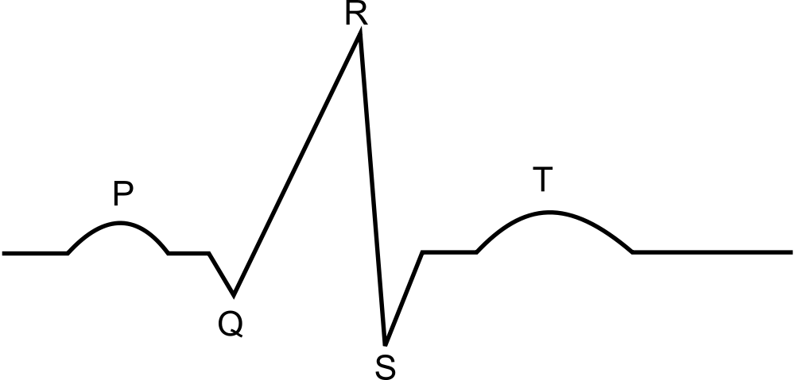

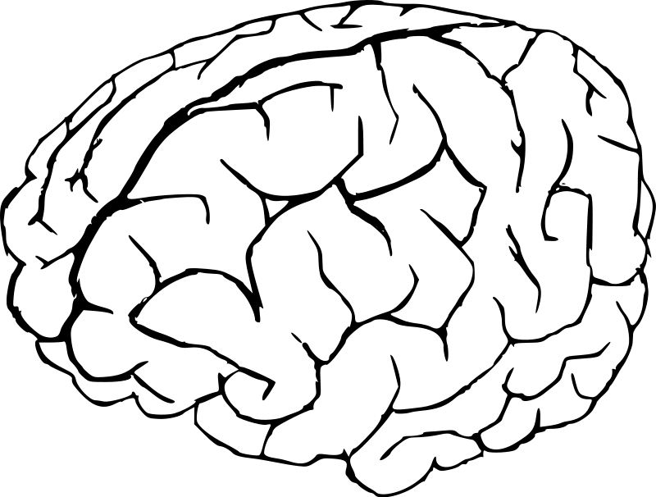





Structure and administration
MRI | ECG
{
“recordings”
MRI | ECG | DNA | ...
MRI | ECG | DNA | ...
 |  |  | ...
 |  |  | ...
 |  |  | ...
{
“athletes”
PEP just stores data
PEP stores tabular data
...in a structure defined by a Data Administrator
Producers have data on subjects
...and an Access Administrator grants write access
...so that the data may be uploaded
Each subject’s data are stored in a separate row
...and multiple producers may contribute data
Data administrator defines subject groups
...and column groups
Access Administrator grants access to such groups
...allowing analysts to download the intersection
So from a user’s perspective...

Slide 12
Polymorphic pseudonymization
MRI | ECG
DNA | ...
 | ...
 | ...
0001
(context boundary)
9509
7561
7561
0002
0002
3593
3593
0003
8663
(context boundary)
(context boundary)
MRI | ECG | DNA | ...
 |  |  | ...
 |  |  | ...
 |  |  | ...
0001
0002
0003
PEP just stores data
Administrators configure multiple authorizations
...providing different users with different data (sub)sets
Each row contains data from a single subject
...but subjects should remain anonymous
...and data blending should not be possible
Fixed subject (row) identifiers would allow for blending
...so instead each user gets individualized identifiers
...preventing subject IDs from being matched across contexts
But from each individual user’s perspective...

Slide 13
Pseudonymized upload
MRI | ECG
DNA | ...
 | ...
 | ...
DNA | sex | age | ...
 | F | <30 | ...
 | F | >40 | ...
9509
7561
7561
<30
3593
8663
8663
>40
age | MRI | ECG | DNA | ...
 |  |  |  | ...
<30 |  |  |  | ...
>40 |  |  |  | ...
age | MRI | ECG | DNA | ...
 |  |  |  | ...
 |  |  |  | ...
 |  |  |  | ...
MRI | ECG | DNA | ...
 |  |  | ...
 |  |  | ...
 |  |  | ...
PEP just stores data
Data analysis may yield additional information
...some of which the analyst may want to contribute back to PEP
Administrators can provide an additional column
Users upload data using their personalized row identifier
...allowing PEP to store the data in the correct rows
...without PEP or the uploader learning the subjects’ identities
But from the uploader’s perspective...

Slide 14
Data visibility
MRI | ECG
DNA | sex | age | ...
 | F | <30 | ...
 | F | >40 | ...
DNA | sex | age | ...
 | F | <30 | ...
 |  |  | ...
DNA | sex | age
 | F | <30
DNA | sex | age
 | F | <30
9509
7561
3593
F
>40
8663
age | MRI | ECG | DNA | ...
 |  |  |  | ...
<30 |  |  |  | ...
>40 |  |  |  | ...
age | MRI | ECG | DNA | ...
 |  |  |  | ...
<30 |  |  |  | ...
 |  |  |  | ...
>40
PEP just stores data
Users only see the data that they are authorized for
Some data may be absent from PEP
...so downloaders may have gaps in their data sets
...preventing them from analyzing those data
...and from uploading derived data
Users may even see no data at all in some rows
Empty rows are inaccessible: the data set just looks smaller

Slide 15


Short pseudonyms (data point identifiers)
DNA | dnaID
 | dna980
 | dna028
 | dna406
dnaID
dna980
dna028
dna406
dna
406
MRI | ECG
1068
MRI | ECG | dnaID
 |  | dna980
 |  | dna028
DNA | sex | age
 | F | <30
9509
0399
7561
8762
3593
8762
(context boundary)
age | MRI | ECG | DNA | ...
 |  |  |  | ...
<30 |  |  |  | ...
 |  |  |  | ...
age | MRI | ECG | DNA | dnaID
 |  |  |  | dna980
<30 |  |  |  | dna028
 |  |  |  | dna406
dnaID
dna980
dna028
dna406
?
Empty rows are inaccessible: the data set just looks smaller
Data producers process (sample / measure / ...) subjects
...and receive authorization to upload those data to a specific column
Produced data must be stored in the appropriate row
...but the PEP row is not associated with the subject’s identity
...so producers won’t know where to store data for any particular subject
PEP helps by generating “short pseudonyms” as data point identifiers
Producers download the short pseudonyms
...receiving personalized row identifiers (just like other users)
Subjects bring their (own) short pseudonym to their measurement
...allowing the producer to look it up in their table
The producer associates the data with a PEP row
...and the (individualized) row ID allows upload to the correct location
Producers only know about “their” data and associated short pseudonyms
Other users must never learn short pseudonym values
...since the fixed identifier would allow for data blending across contexts

Slide 16



Blending of overlapping data sets
DNA | dnaID
 | dna980
 | dna028
 | dna406
MRI | ECG
1068
MRI | ECG | dnaID
 |  | dna980
 |  | dna028
ECG | DNA
9509
7080
0399
7080
3593
5697
8762
3593
age | MRI | ECG | DNA | dnaID
 |  |  |  | dna980
<30 |  |  |  | dna028
 |  |  |  | dna406
MRI | ECG | DNA | ...
 |  |  | ...
 |  |  | ...
 |  |  | ...
...since the fixed identifier would allow for data blending across contexts
Different authorizations may (partially) overlap
...so different downloaders may have (partially) overlapping data sets
Row identifiers are individualized to prevent data blending
...but the data themselves are identical
...so matching the data allows for blending after all
Data use agreements (must) prohibit such blending

Slide 17
PEP
Polymorphic Encryption and Pseudonymization
Data repository with built-in encryption and pseudonymization
Technical tool to help keep data secure and identities protected
Requires proper configuration and administration
Not a golden hammer
But we like to think that it’s at least a silver screwdriver

